Slide 1


Welcome
Miss Willoughby’s Class
Year 1

Slide 2


Purpose of tonight’s meeting
Gain an understanding of year 1
Our routines and organisation
Our year 1 curriculum
Our school values and houses
Home learning opportunities
The importance of reading
How to contact me
Time for questions

Slide 3

Helping you to understand what Year 1 is like
Everyone is welcome no matter what their need, ability, confidence or circumstance
Focus on developing self confidence and independence
Hard work, but we like to have fun
Practical learning as much as possible

Slide 4
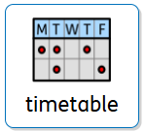

Our routines and organisation
Children enter via the infant gate or KS2 door if they are coming in with siblings and are confident to find the classroom independently.
Children are encouraged to organise themselves when they arrive in class (lunchboxes onto the landing table, bookbag in drawer, coats on peg, drinks bottle in the box). An adult will support with this until they are confident to do this independently.
Children are greeted by myself or a member of the Year 2 team at the door with a good morning.
Children begin their morning task as soon as they are organised for the day. These focus on key Maths skills and are an important part of our routine.
We continue this morning work until 9:15am and then have 50 minutes of Phonics.
Work during the day has adapted expectations designed to support or deepen understanding for each child.
Mrs Jackson teaches the children arithmetic and spag on a Tuesday morning after Phonics. There may be other times when one of our HLTA’s will cover the class to allow me to fulfil my Senior Leadership role within the school.

Slide 5
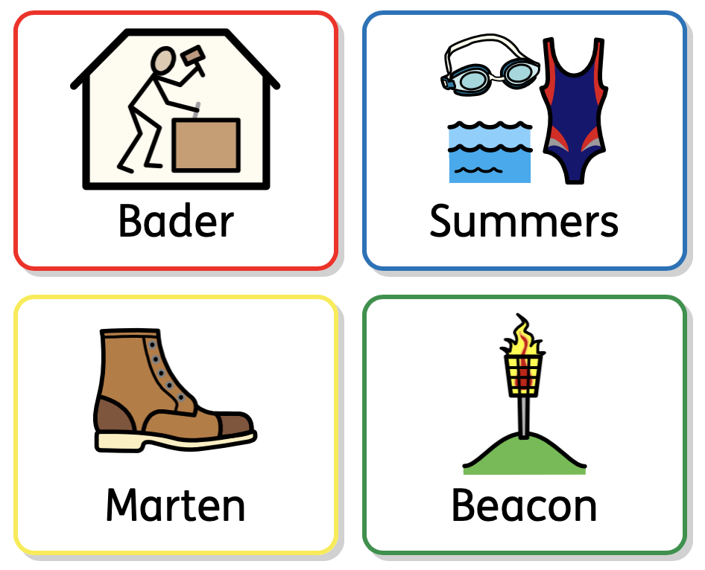
Our School values and houses
Your child remains in the same house as last year. If your child is unsure, please let me know and I can find out.

Slide 6

Our Year 1 Curriculum
Autumn Term
Literacy How to grow a unicorn (instructional writing) The Queen’s Hat (narrative writing) | Maths Place Value Addition and Subtraction Shape | Science Seasons | History How am I making History?
Geography What’s it like here? | PE (indoor) Handball | PE (outdoor) Football | Art Drawing
DT Constructing a windmill | Music Pulse and rhythm | ICT Technology around us | RE How do people know how to treat each other?
PE Days are
Monday Outdoor and Thursday Indoor

Slide 7


Slide 8
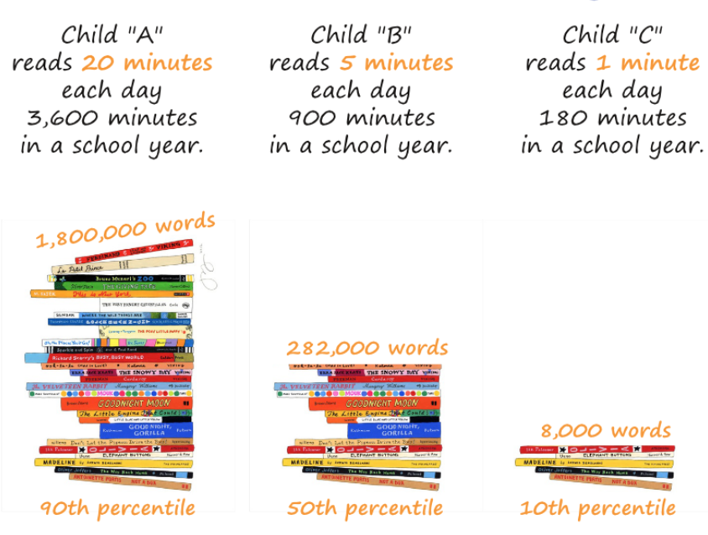
Home learning opportunities
Read with your child 5 times a week at home
Read to your child – this helps them develop a strong understanding of language
Phonics videos – QR codes
Opportunities to develop personal independence skills e.g. tying shoelaces, riding a bike with pedals with/without stabilizers
Extra curricular clubs – please encourage your child to share their achievements from clubs with us – we celebrate these fortnightly in our whole school assembly

Slide 9

The importance of reading
In school we listen to children read in EVERY phonics lesson.
We use ‘Talk through stories’ to ensure our children develop strong vocabulary and comprehension skills.
Our writing lessons use high quality texts as inspiration
We give the children 3 books to read which they can choose from for home reading – these include the scheme book which is a familiar read, the book bag book which is a new book of the same challenge level and a library book to encourage shared reading with adults at home.

Slide 10

How to contact me
Morning messages can be dropped off with staff at the gate.
Phone school if something is urgent/time sensitive as I do not always see emails arrive when I am teaching.
Please use the school number 01933 664291 to get messages that need to reach me within the school day for action, such as a change to home time collection.
However, the best way to contact me will usually be by email. jennifer.willoughby@WPS.inmat.org.uk As a school we endeavour to answer all emails within 24 hours

Slide 11

Any questions?
If there is something you think of later, please don’t hesitate to email

