Slide 1



Transition from EYFS to Year 1
Wollaston Primary School
Summer 2026

Slide 2
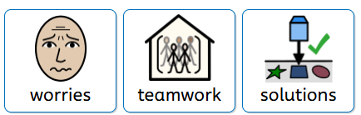
What is important when children move on
Moving on and leaving something that is familiar and comfortable can be a scary prospect for you and your child.
We want to ensure we can work together to make this a smooth transition for your child.
When thinking about this, we have tried to consider:
Child worries
Parental worries

Slide 3
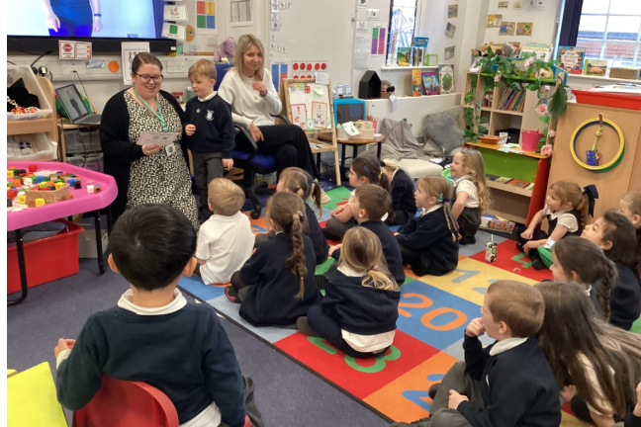
How do we support your child’s transition
To help support transition we:
Have transition meetings between current teacher and new teacher to share information about your children
Spend time getting to know the children, this includes 2 transfer days and other opportunities such as sharing story time and learning time together in the Summer term.
Build relationships with each child. This has been happening since your child first came to us in September.
Send familiar items to have in the classroom in September – this includes their Zog book and Fred book which we can share together in year 1. This shows the children that what they learn in EYFS is not separate, but a part of their ongoing journey.
Year 1 teacher regularly pops in to say hello to the children in EYFS
EYFS teachers regularly pop in to say hello to the children in the Autumn Term and find out what they have been learning about in year 1.

Slide 4
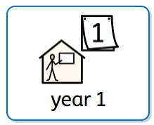
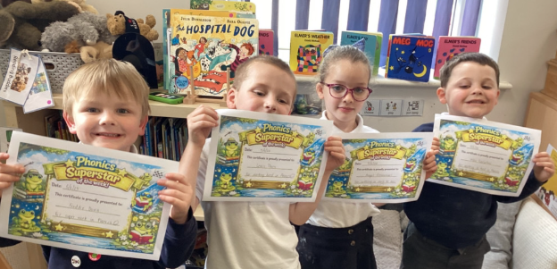
What will it be like in Year 1?
We like to think about what will be familiar to our children in year 1 rather than focussing on what is different, it helps to create a positive mindset.
To help your child find familiarity in the new learning space, they should expect to find:
a book corner with books that are familiar to them from their EYFS journey
fruit to eat at playtime
Talk through stories at the end of the day – we will also revisit some of their favourite stories from EYFS.
Book change Friday
Raffle tickets for Phonics in school and for Reading and accessing Phonics videos at home and Phonics Superstar Awards – there will still be a prize at the end of term!

Slide 5
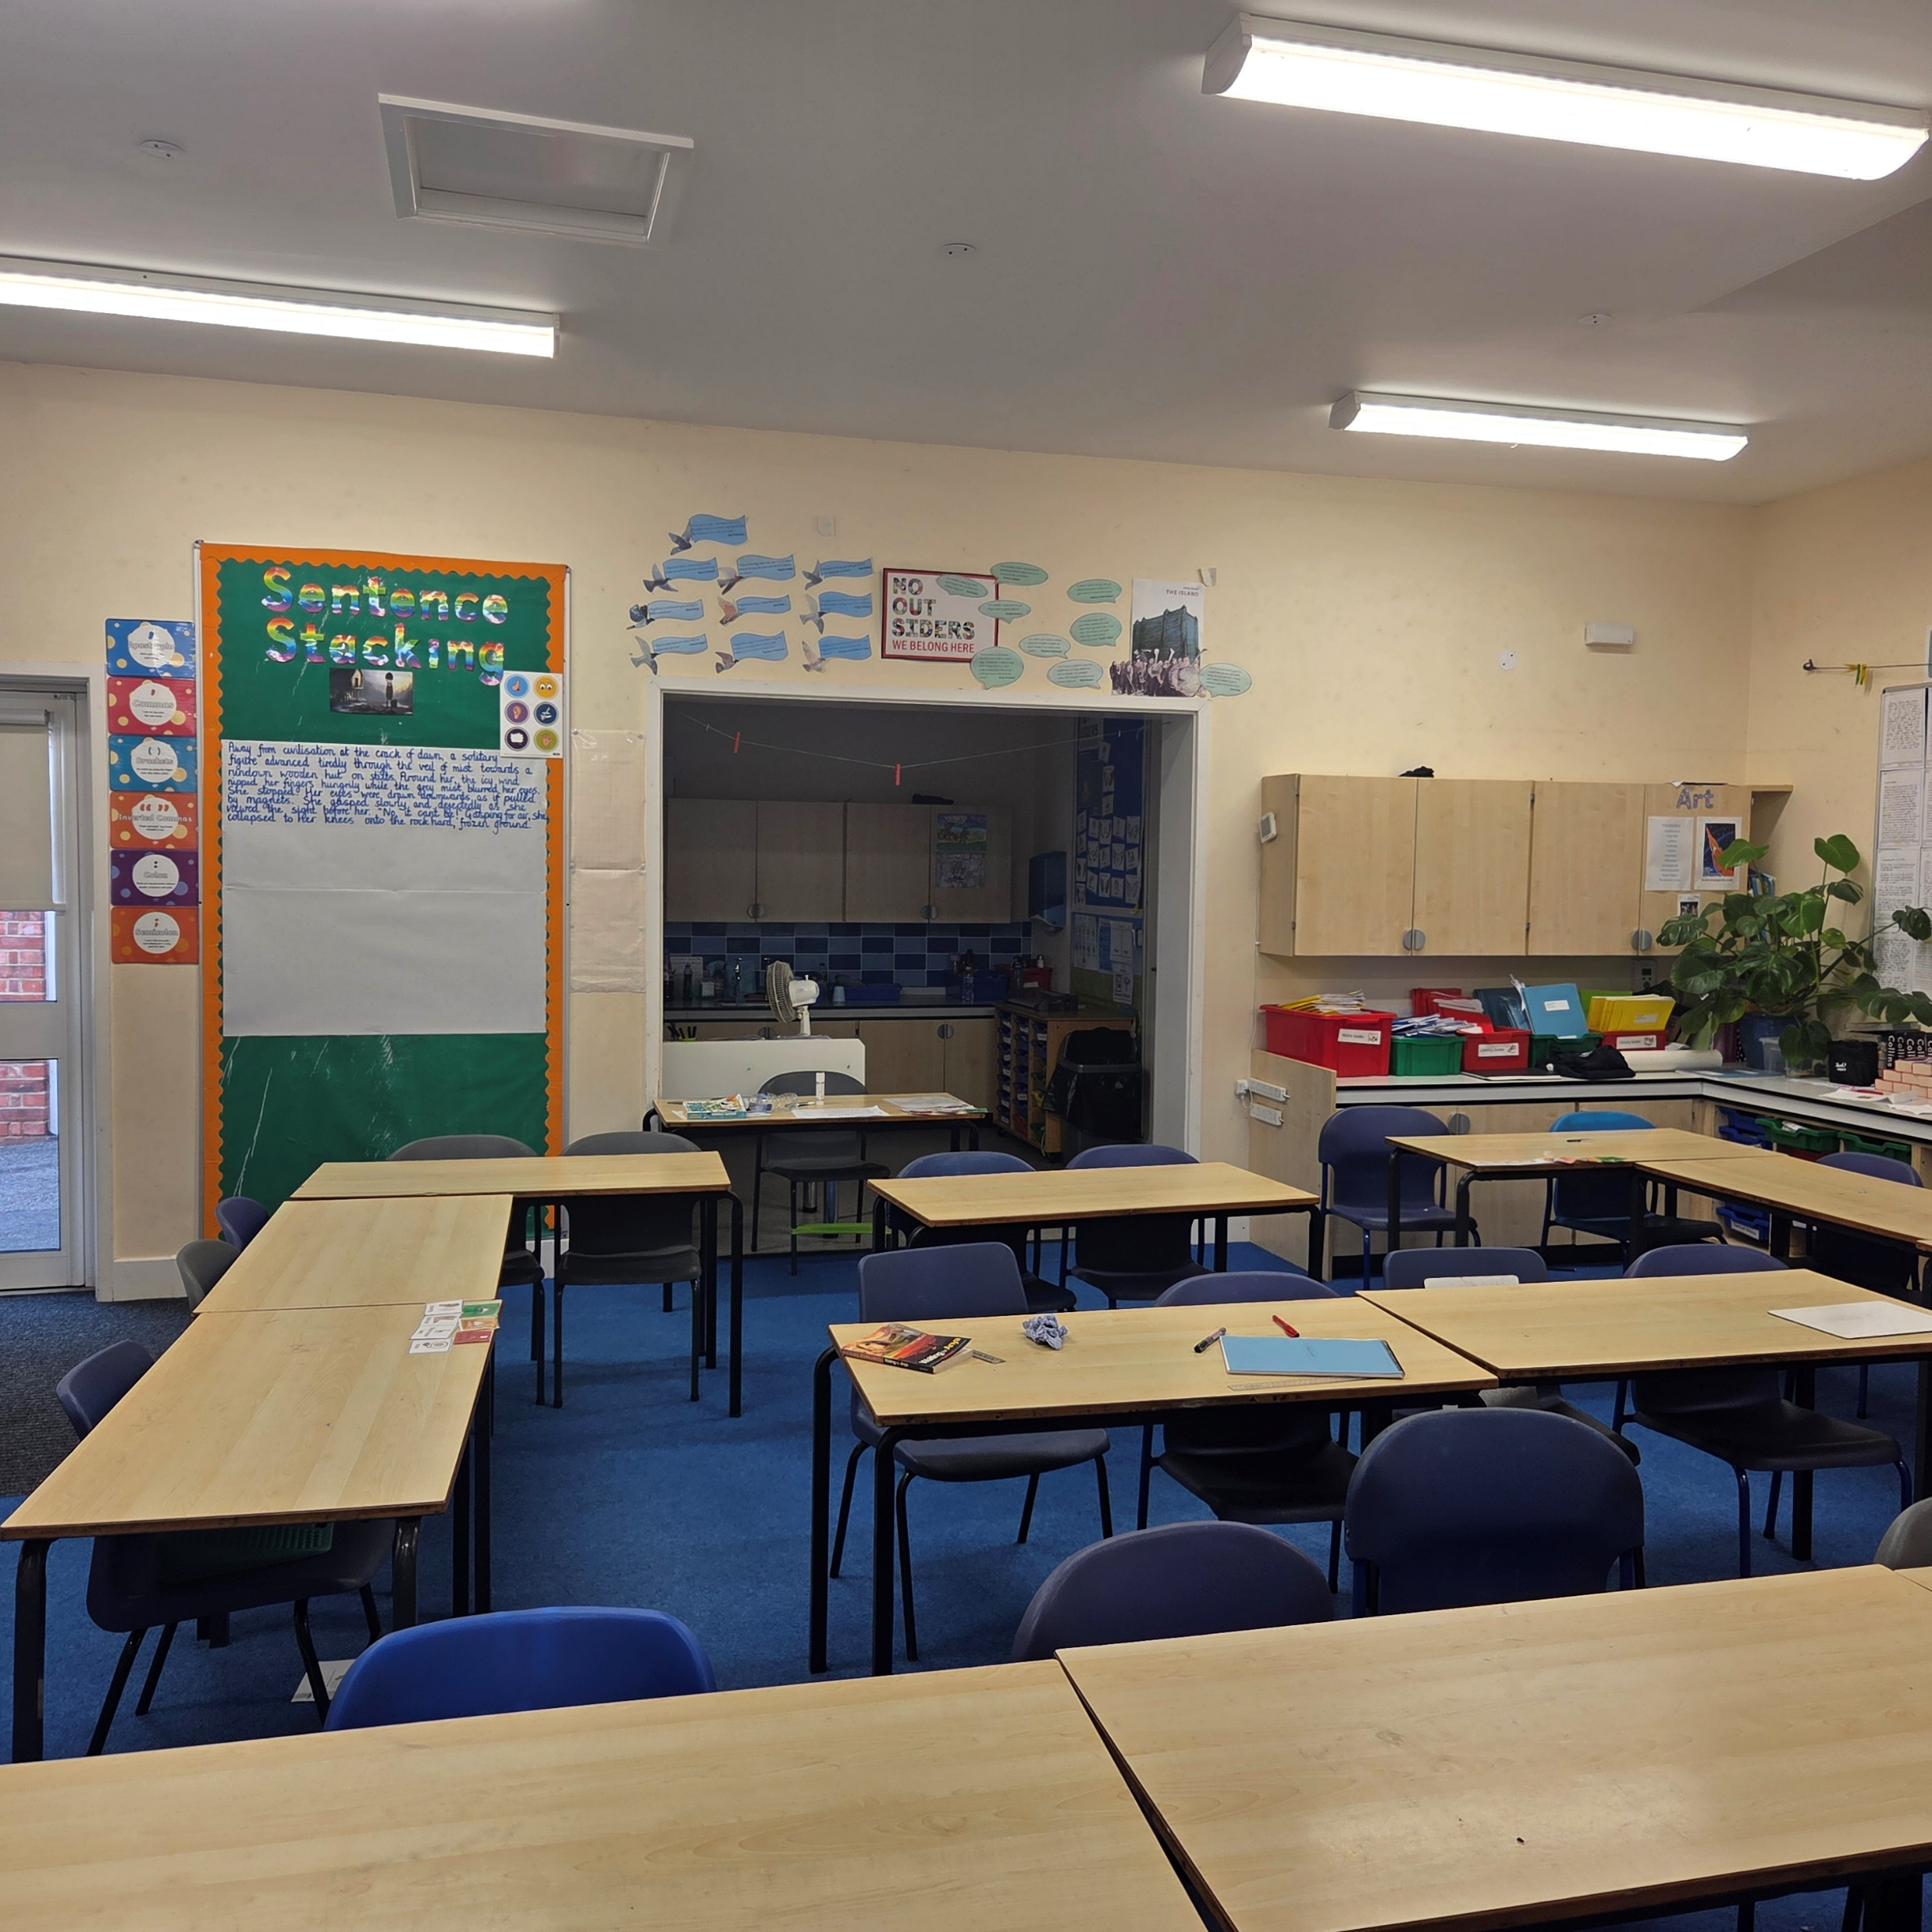
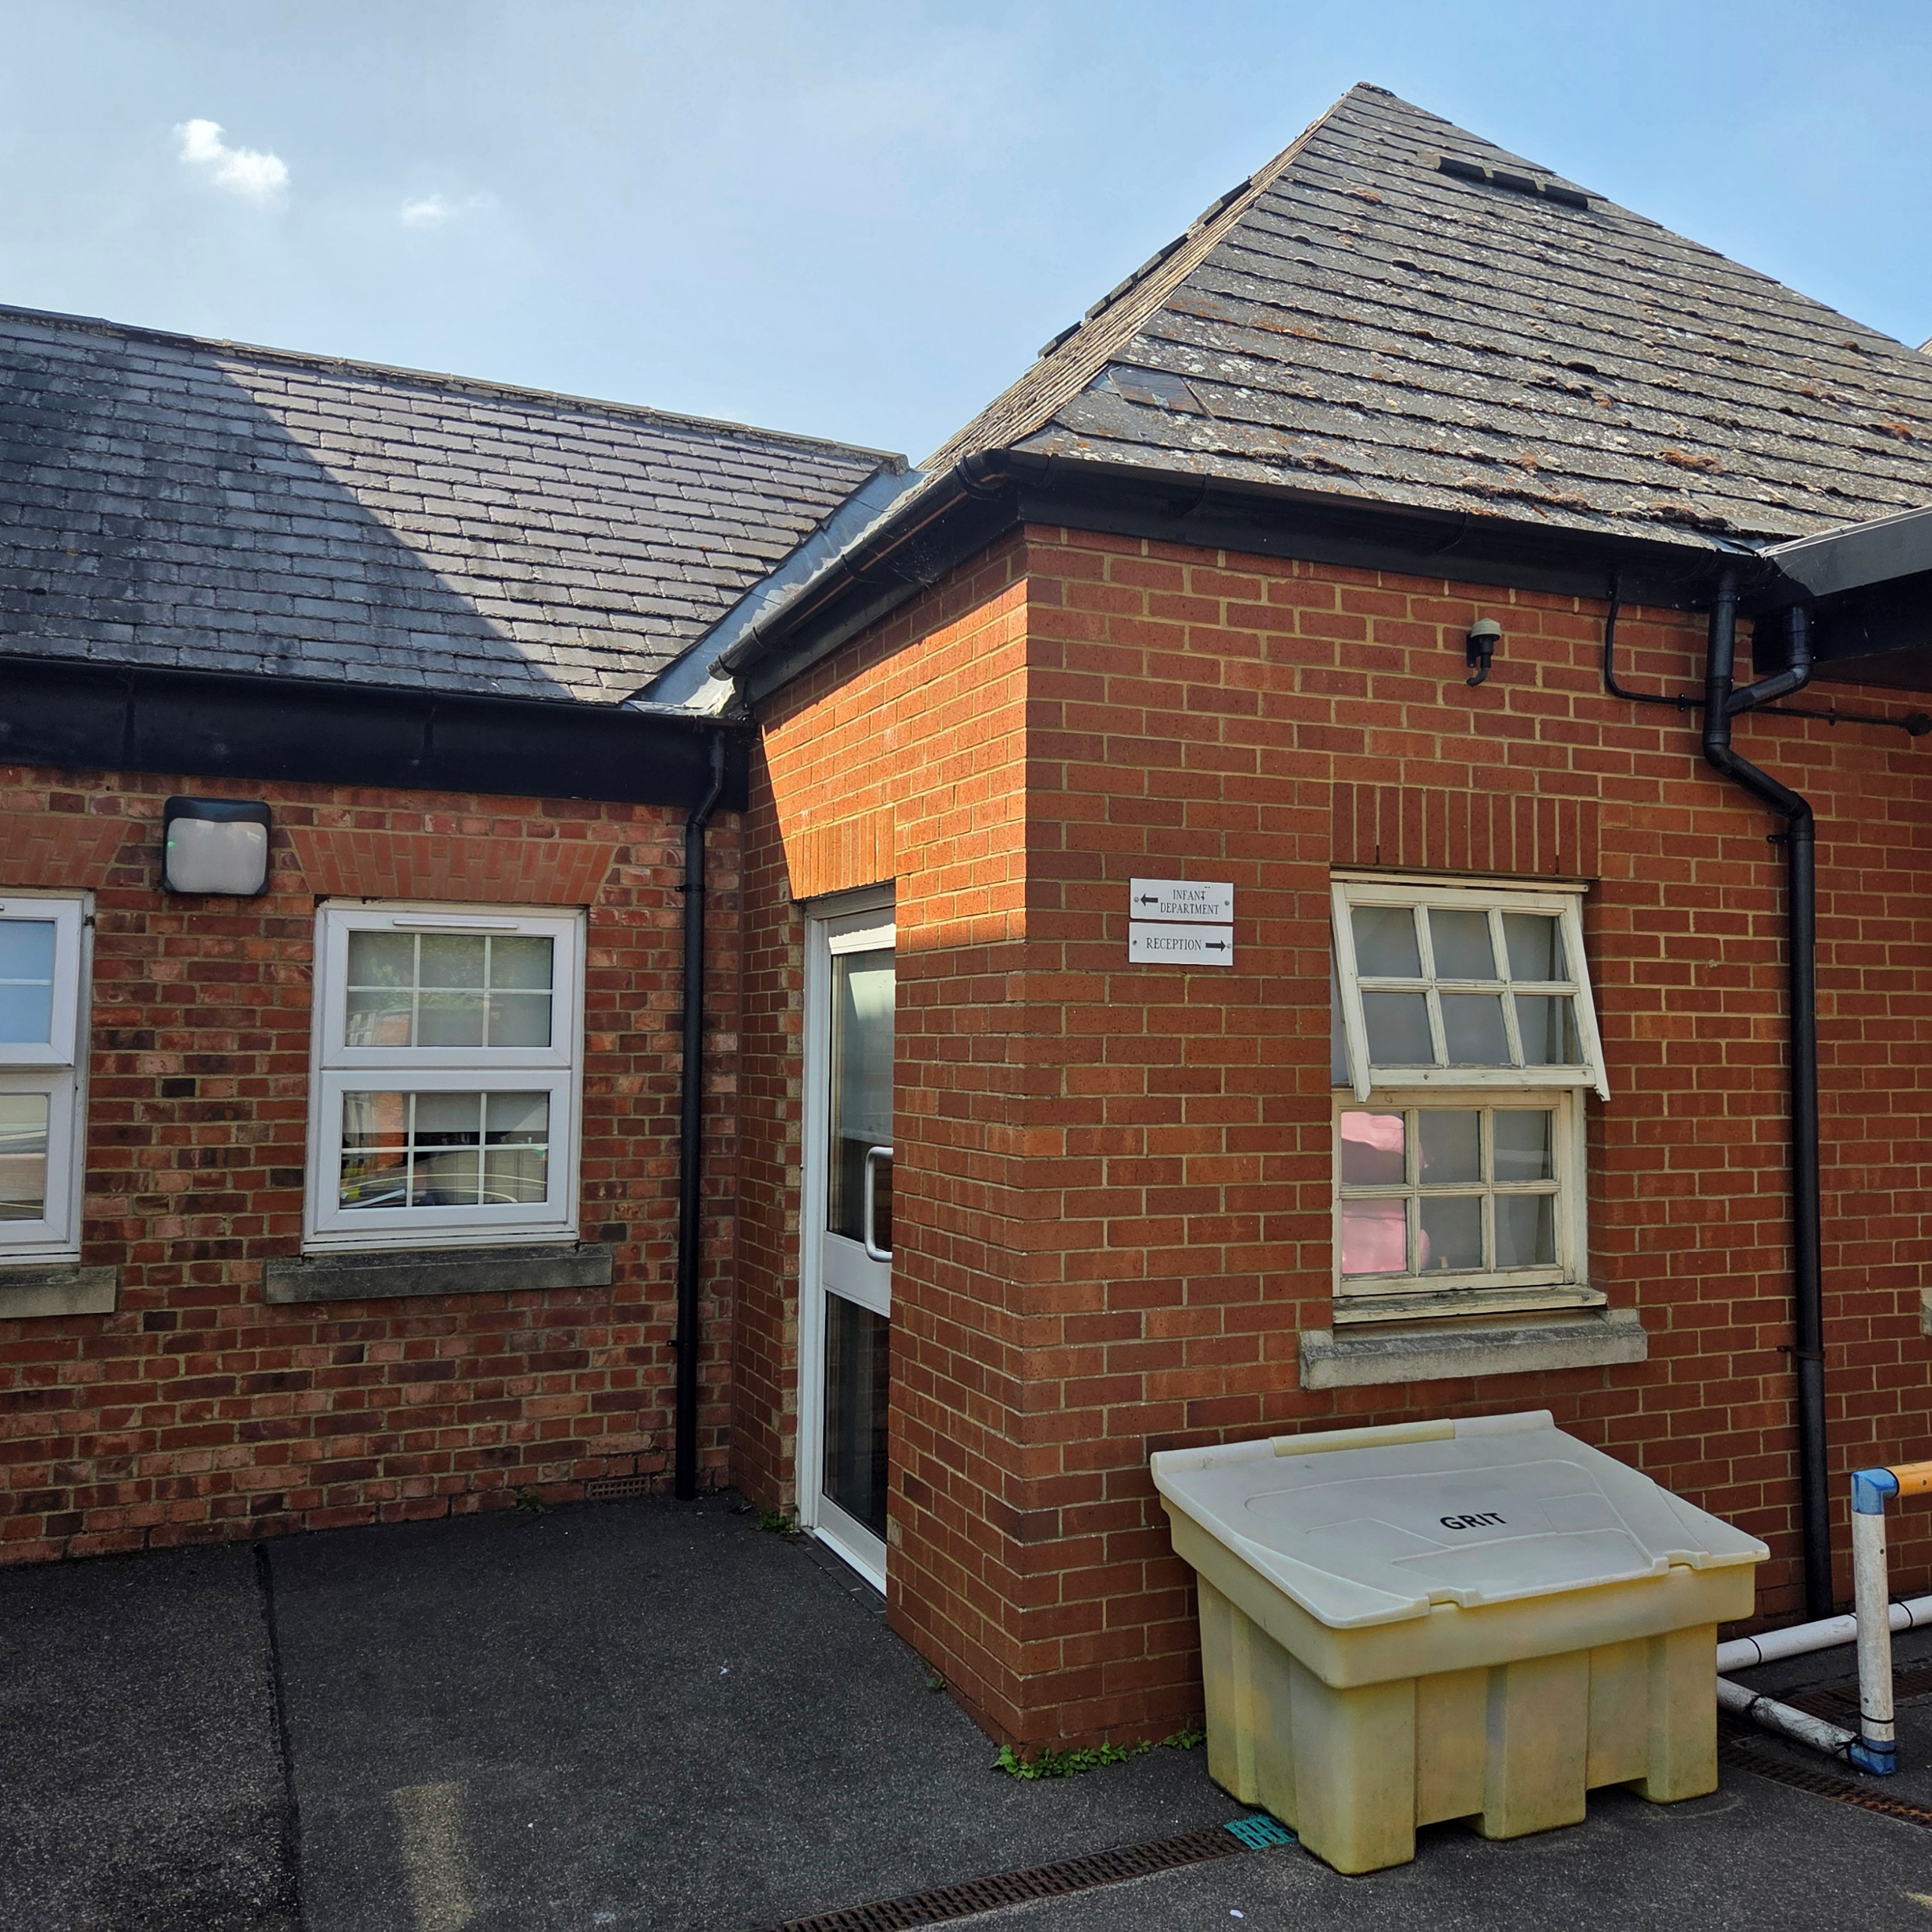
What will it be like in Year 1?
Our classroom – it will look a bit different in September as it is currently a year 4/5 classroom.
This is the exterior door to our classroom which is your drop off and pick up point next year.

Slide 6
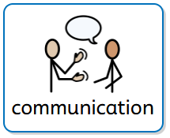
Communication
We recognise the importance of knowing how your child is getting on at school. Unfortunately, we do not use Tapestry after the end of EYFS.
However, we do have:
An event in September to visit your child in class and see their learning space
Termly, whole school newsletters to show what we have been up to
2 parents evenings (October and March) to see your child’s books, talk about their settling and progress, as well as ask any questions you may have
School social media (Instagram and Facebook) updates about our learning
Knowledge organisers to help you understand what your child is learning about across the curriculum – these are available on our school website
Staff emails – we do respectfully request you allow us 24 hours during term time to respond to emails, but we are happy to answer questions by email if this is easier for you

Slide 7

Communication
This year in year 1 we are trialling a new way for you to keep up to date with what is happening in year 1.
Class Dojo is an app we will use to help children see the house points they have collected add up. It will also serve as a blog where we can share snippets of year 1 life.
Please note we will not be utilising the chat feature on this app and communication with Miss Willoughby should be via email jennifer.willoughby@wps.inmat.org.uk in line with the rest of the school. Arbor will still be the main form of communication for letters and information about school events and such.
Information for how to sign up for an account linked to your child will be sent to you before the end of the academic year. Watch this space!

Slide 8

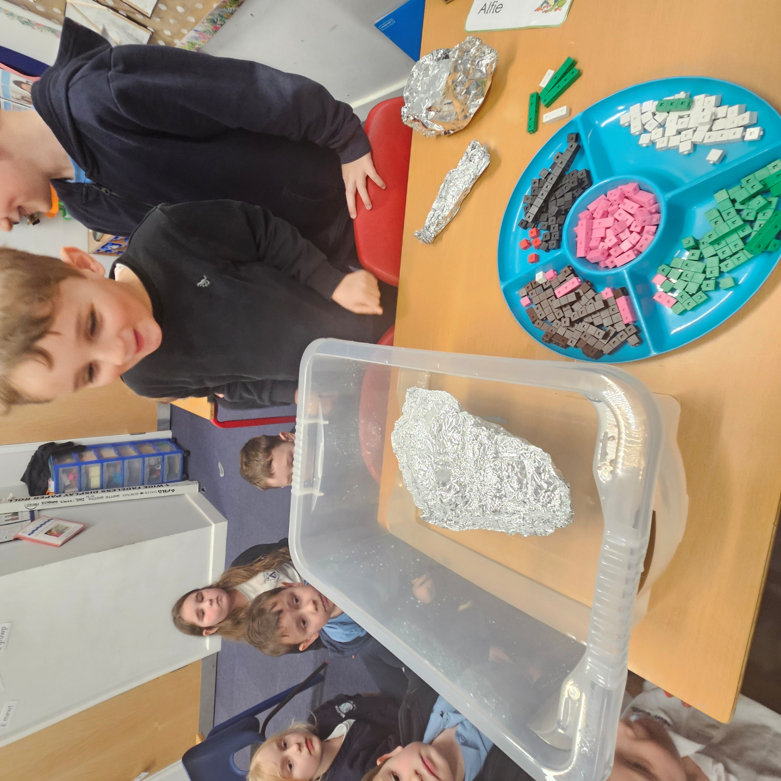
Comparing the curriculum in EYFS and Year 1
EYFS
Curriculum is divided into 7 key areas of learning, 3 prime areas and 4 specific
Prime Areas – Communication and Language, Physical Development, Personal, Social and Emotional Development
Specific Areas – Literacy, Mathematics, Understanding the World, Expressive Arts and Design
Years 1-6
Subject focussed curriculum covering:
English (this includes Phonics and Reading as well as Writing)
Maths
Science
PE
RE
PSHE
ICT
History
Geography
Art
DT
Music
Children this year are already accessing lessons of History, Geography which help them fulfil the curriculum requirements for Understanding the World

Slide 9
How can I help my child prepare for Year 1
Talk positively about being in year 1
Remind them that their EYFS team will still see them and will love to hear about their start in year 1
Reflect on things that will be familiar in year 1, for example, we will still bring our bookbags and drinks bottles to school, we will still change books on a Friday, we will still choose children to receive values awards
Continue to encourage independence, communication and social interaction through play and family activities
Establish healthy routines in the lead up to September including healthy eating, sleep and screen time rules to support overall well-being
Send your child with a photo of a special summer memory that they have practised talking about at home. This can be used to make connections with your child and learn about what has fuelled them over the summer.

Slide 10
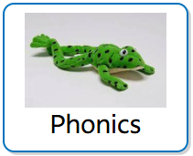
Phonics Screening Check
Each June, all Year 1 children are required to sit the Phonics Screening Check (PSC)
The phonics check is a short, one-to-one activity with a teacher. It involves reading 40 words – some are real words, and some are made-up ‘alien’ words. The aim is to see how well children can use their phonics skills to decode unfamiliar words. It usually takes 5–10 minutes and is designed to be a positive and encouraging experience.
Why it’s important
Phonics is a key building block for reading. The check helps us identify any areas where your child may need extra support, so we can help them become confident, fluent readers.
Please remember, the check is not a formal test – it’s simply a way for us to celebrate your child’s progress and plan their next steps in reading.

Slide 11
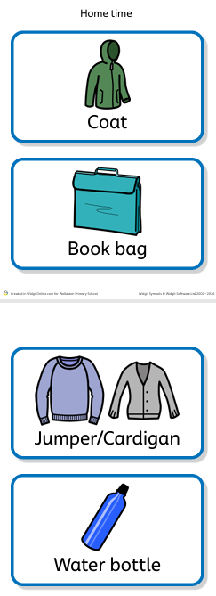
Final thoughts
Please continue to send your child to school with their bookbag.
This encourages them to be able to pack their things up at home time and keep their belongings safe. Year 1 children struggle to manage backpacks so we respectfully request bookbags are used as main bags in year 1. We use Widget symbols to help them remember their things at home time.
Please continue to send a bag of named spare clothes that your child can keep in school.
The children have a peg where this can be stored.

