Slide 1


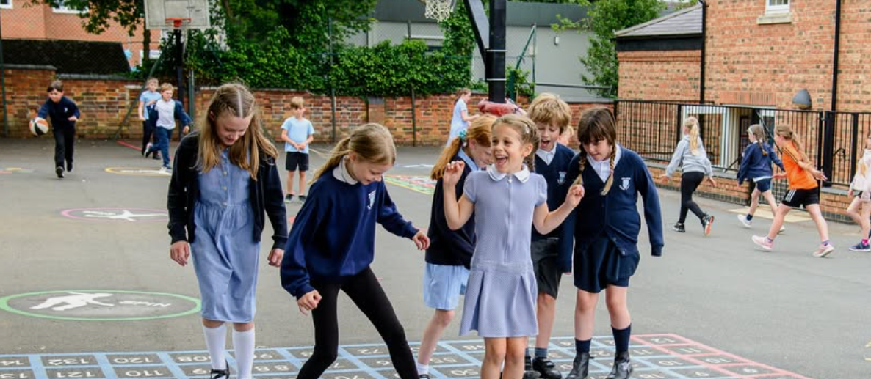

Wollaston Primary School
SEND Information Report 2026-2027
Reviewed September 2026
NEXT REVIEW SEPTEMBER 2027

Slide 2
Welcome to our School SEND Information Report
Reviewed September 2025
NEX SENDT REVIEW SEPTEMBER 2026
At Wollaston Primary School we strongly place nurture at the heart of every school day. We pride ourselves on the pastoral support that we offer our children and families, and openly welcome our families in sharing with us any problem or concern as we promote a team of support around each child. We understand that children learn best when they feel safe and happy, and strive to ensure that every child feels a sense of belonging in their class, and as part of the wider school community. We are proud of the achievements of every child in our care and understand the importance of celebrating the small steps alongside the larger leaps of progress.
Why do we need a SEND Information Report?
The purpose of a SEND information report is to inform the reader about how we support children with a special educational need within our school community.
Our report outlines the support that is put into place across the school year for our children and aims to provide answers to questions that parents and carers may have about our school based support.

Slide 3

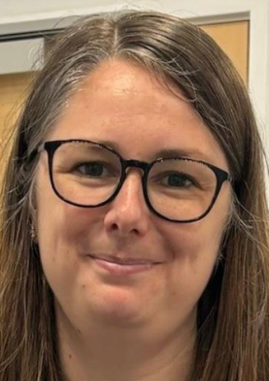
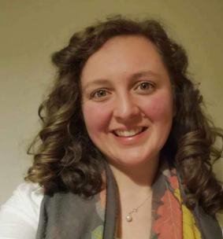
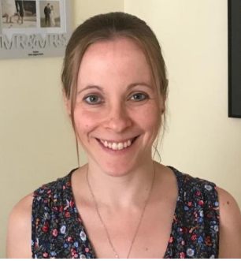
Our Wollaston Send Support Team
Reviewed September 2025
NEX SENDT REVIEW SEPTEMBER 2026
We are fortunate to have developed a SEND support team within our school. Whilst every teacher is expected to be a ‘teacher of SEND’ our team strategically support, lead and manage SEND processes and support across school. Whilst email contacts for our SEND team are readily available our staff do have teaching responsibilities and may not be available at points of the day.
Zoe.Richards@wps.inmat.org.uk
Alison.pullin@wps.inmat.org.uk
Katie.Green@wps.inmat.org.uk
Trisha.coates@wps.inmat.org.uk
Wollaston Primary School, College Street, NN29 7SF
01933 664291
Mrs Green- SENDCO and Deputy Safeguarding Lead.
Mrs Coates-EHCP manager-Mon-Wed
Mrs Richards-Headteacher and safeguarding lead
Miss Pullin-Deputy Head, Deputy Safeguarding Lead

Slide 4
Our SEND Identification Process
Reviewed September 2025
NEX SENDT REVIEW SEPTEMBER 2026
What should I do if I have a concern about my child?
At Wollaston Primary School we understand that many of our children may present differently at home to at school. We encourage parents and carers to share concerns with the SEN team via email in the first instance to ensure that records are consistent, and a chronology of your child’s needs can be maintained over time. Our SEND team meet regularly and actively promote early intervention for all of our children. Once a concern has been raised the SEND team will gather information from your child’s teacher, consider logs that may already be held on our Myconcern system and may observe your child in class and during unstructured times. Gathering as much information as possible ensures that the right plan is put into place and appropriate referrals can be made. Parent meetings are often arranged to ensure there is a support team around a child and to work together to agree actions and targets.
What happens if a teacher has a concern about my child?
If a teacher or member of staff has a concern regarding your child’s progress, behaviour or development they will be asked to complete a class teacher concern sheet. This will collect assessment data, observations made in class and evidence of work where this is helpful. Once information is gathered the SEN team will consider evidence gathered and a parent meeting may be arranged to agree next steps, actions and targets. In some cases a period of monitoring over time may be needed to explore concerns fully.

Slide 5

Who Else Can I Seek Support From For My Child?
Reviewed September 2025
NEX SENDT REVIEW SEPTEMBER 2026
We have a number of strong links with outside agencies who regularly support and communicate with our SEN team. Many of these services can be accessed without a referral from school and often seeking self-referrals can be quicker than school based processes. We often recommend the following services:
The 0-19 School nursing team- they can be contacted via telephone or the online chat service on their page-Children’s 0-19 Services | NHFT
Your family GP- they can refer to many services and are able to access the Right To Choose Pathway (this cannot be referred into by school)
Service 6- accept self referrals- Service Six- Welcome- Mental Health and Wellbeing Support
CAHMS consultation line-The CAMHS Consultation Line is a telephone advice line for parents, carers, young people, and professionals seeking guidance on the emotional wellbeing or mental health of a young person. It is available from Monday to Friday, 9am to 7pm, and can be reached at 0800 170 7055
Specialist Support Service-SEND Support Service | North Northamptonshire Council
IASS- SEND information and Advice Support Service-SEND Information Advice Support Service | North Northamptonshire Council
ENFOLD-Autism Support Hub-Enfold - Your local autism information hub
ADHD Wise UK- courses and support for parents-ADHDWISE UK - ADHD Wise

Slide 6
The Four Areas of SEND
Reviewed September 2025
NEX SENDT REVIEW SEPTEMBER 2026
Special Educational Needs are categorised into 4 areas:
Social, Emotional and Mental Health | Cognition and Learning
Children may experience a wide range of SEMH difficulties. These can emerge at different times in different ways. Early intervention is always important at the first sign of concerns. This can include ADHD, ADD and attachment disorder alongside anxiety. | Some children may learn at a slower pace to their peers, even with adapted tasks. Some children may have learning difficulties where they experience challenges across the curriculum. Dyslexia, dyscalculia and dyspraxia (DCD) are all specific learning difficulties.
Communication and Interaction | Physical and Sensory
This area includes speech, language and communication. Some children may have difficulties producing clear speech or using and understanding language. Some children may find social communication difficult including those who are autistic. | Some children have a physical disability that requires adaptations to the environment. This ensure they can access everything school has to offer. Children may require specialist support with hearing, sight, sensory or health. Specialist equipment may be needed.

Slide 7
Types Of SEND Support
Reviewed September 2025
NEX SENDT REVIEW SEPTEMBER 2026
Ordinarily available provision- our universal offer | SEND monitoring | SEND support | Education and Healthcare Plans-EHCP
This provision is available to all of the children in our care. This includes common practice in the classroom and Quality First Teaching. It may provide support in a lesson-individually or in a small group, check ins with an adult or some adaptations to work. This ensures a good quality of education for all children and supports every child in making progress. | When concerns may begin to emerge a child may be placed on our SEN monitoring register. Not every child with a diagnosed need will require additional support, but they will require careful monitoring of changes over time. The SEN team will keep track of progress and meet with class teachers or parents to support concerns. A pupil passport may be created. | Where a child requires support that is additional to or different from their peers, or where a high level of support is needed they will be placed on the school SEN register. They will have a pupil passport and learning plan which will be reviewed 3 times a year, unless changes are needed sooner. These children may be being supported by outside agencies and have specific targets that are tracked by the SEN team. | Very few children will require a formal assessment by the local authority. These children will need very high levels of sustained, long-term support from external professionals from education, health or social care. Parents and professionals can request an assessment. Education, Health and Care Plans (EHCP) | West Northants SEND IASS

Slide 8
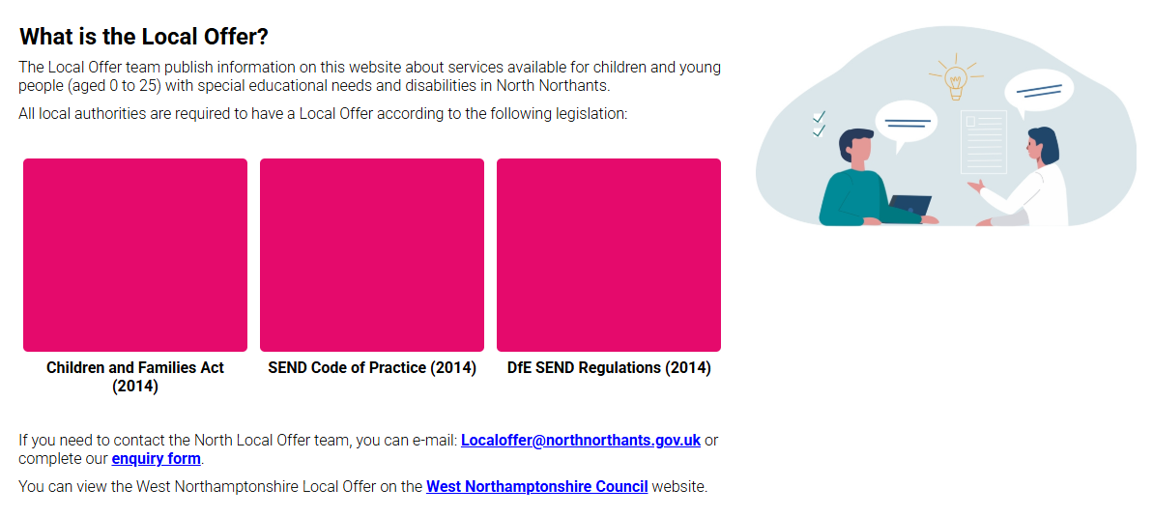

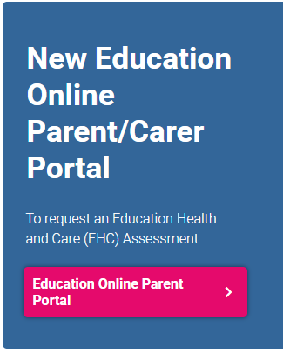
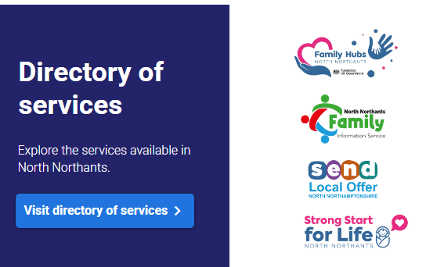
What is the Local Offer?
What is the Local Offer?

Slide 9
Universal, Targeted and Specialist Support- how is support delivered?
Universal Support- Available to all of our children | Targeted Support- for children on our monitoring or SEN register | Specialist support- for children on our SEN register or with an EHCP
This is often called Wave 1 support. This is predominantly led by quality first teaching. All of our teachers are teachers of SEND and are provided with regular opportunities to access training and to work alongside our SEN team. As much as possible intervention inside the classroom is encouraged and supports our children in developing a sense of belonging in their classes. This is monitored during core meetings and through learning walks. | This is often called wave 2 support. At times it is necessary for staff to provide targeted support for our children, which may include specific interventions or reasonable adjustments. Reasonable adjustments are made to ensure that every child with an additional need is as fully included in every aspect of school life. Support may be sought from outside agencies as needed and may be monitored by the SEN team. | This is often called wave 3 support. It may be necessary to involve additional professionals such as educational psychology, speech and language or outreach professionals to advise and support. Referrals are only made with the agreement of a parent or carer. This may include significant adaptations to our environment, lessons and specified interventions. There is often a waiting list for services and this can be long in length.

Slide 10
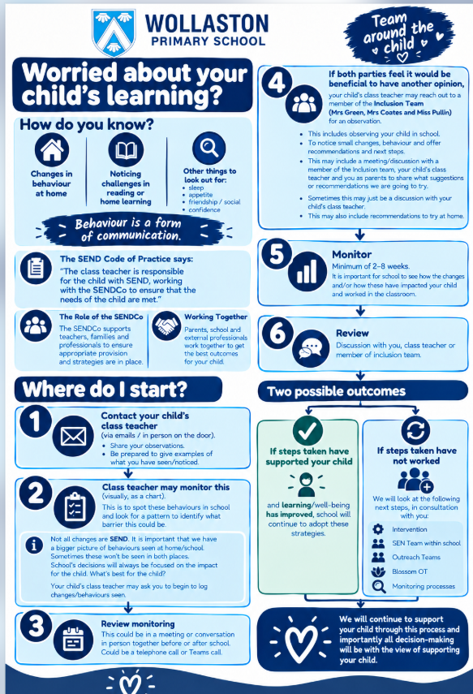

Slide 11


Assess, Plan, Do, Review- Edukey
Reviewed September 2025
NEX SENDT REVIEW SEPTEMBER 2026
At Wollaston Primary School we use an online system called Edukey to support us in ensuring that we follow a clear cycle of assess, plan, do, review. Evidence of this is required to seek statutory assessment and for some referrals. On Edukey staff will create pupil passports and learning plans. Some children may not require a learning plan and may only have a passport in place. These documents will outline adaptations or challenges that your child may need or face and also may outline targets to be achieved each term. Not every child with a diagnosed difficulty will require a learning plan and these are used in cases where a child requires support that is ‘additional to or different from’ their peers.
Pupil passports and learning plans are managed and written by our class teachers and are monitored by the SEN team. Plans and passports are reviewed termly and parents are provided with an access code. Child and parent voice form a part of these and are central to the process.
More information about SEN support, EHCPs and information from parents can be found here:
SEND Support | West Northants SEND IASS

Slide 12

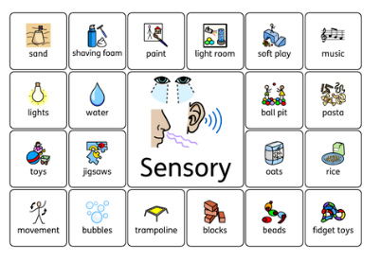
Widget- Visual aids in our school
Reviewed September 2025
NEX SENDT REVIEW SEPTEMBER 2026
Within our school we understand the importance of visuals to support all of our children in understanding learning, our environment and communicating their needs. Your child will become familiar with Widget symbols and these provide a universal communication system. All of our classes are equipped with visual schedules and these may be used individually for some of our children. Widget is available to parents and is easy to use to make resources at home. More information can be found here:
Widget Online

Slide 13
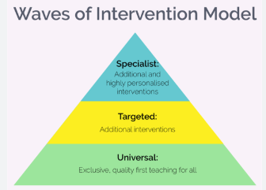
Strategies, Intervention and Staff Training
Reviewed September 2025
NEX SENDT REVIEW SEPTEMBER 2026
Last year our staff delivered the following interventions within our school:
Precision teaching to support reading and spelling
SNIP- Literacy intervention programme designed to support spelling and reading
Fast track tutoring- to support phonics development
My Hidden Chimp- supporting children’s mental health
Starving the Anxiety Gremlin- supporting anxiety
Golden books- developing self-esteem
Sensory circuits- to support regulation
The Never Alone Project- support for children experiencing bereavement
Daily reading- supporting developing pace and fluency
Daily meet and greets- reducing anxiety
Team around the child approach- supporting children’s SEMH needs
Barrier games- supporting listening and attention
Colourful semantics and targeted speech and language
Selective mutism pathway intervention
The conversation train- social support
Word shark- supporting reading and literacy
Now and next communication boards and talking mats
Physical aids guided by OT
Heavy work breaks
Social stories
Part time timetables
Brunch- SEMH support
Intimate care plans
Positive handling plans
Zippy’s friends
Time to talk
Fine and gross motor programmes
Theraputty programmes

Slide 14

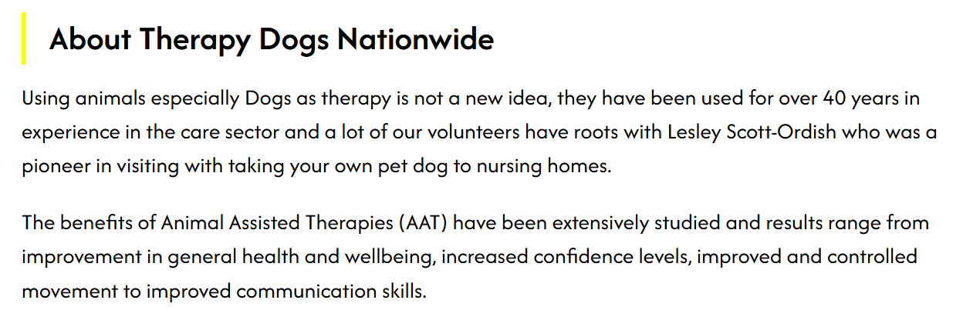
Therapy Dogs Nationwide
Reviewed September 2025
NEX SENDT REVIEW SEPTEMBER 2026
We are very fortunate to be partnered with the Therapy Dogs charity as part of their Reading Dogs programme. Albie and his handler have been linked with Wollaston for the past two years and their visits are very much looked forward to. During sessions children will talk to Albie, read to him and enjoy a cuddle and a fuss before returning to class.

Slide 15

Transition
Reviewed September 2025
NEX SENDT REVIEW SEPTEMBER 2026
Transition in school
Each year great through is placed into the support that our children need to be successful in their next year group or class. All of our children in school join their new teacher for 2 full days. This allows them to explore their new classroom, get to know their peers and to experience how their class will look in the new academic year.
Prior to transfer days staff meet to pass over information and pupil passports are shared. Children will continue to have check ins with their previous teacher and support staff into the new year to ensure that they are happy, settled and to ensure that anxiety is reduced as much as possible.
A meet the teacher evening is held in September and social stories can be found on our website for each class.
Transition between schools
Transitions for children coming into our school, leaving our school and moving to secondary school are carefully managed. We have established links with Wollaston Secondary School and the preschools within the village.
Where children join us as in year transfers contact will be made with previous schools to ensure that all key information is shared.
We welcome families visiting our school and facilitate additional visits for children to secondary school and for those joining us. Transition meetings and documents are shared alongside our Myconcern and Edukey records.

Slide 16

Family Support
Reviewed September 2025
NEX SENDT REVIEW SEPTEMBER 2026
Miss Sparks- Family Support Worker.
Our virtual Worry Box
Children can email worrybox@wps.inmat.org.uk- This is monitored by Miss Pullin
In school Worry Box
Children can post notes or worries in the box and this is checked daily by Miss Pullin, Miss Sparks and Mrs Green
At Wollaston Primary School family support is provided by our Family support worker, SEN and safeguarding teams. Alongside this our Key Stage Leads are always happy to speak to or to meet parents or to listen to concerns.
We do request that any concerns are shared with your child’s class teacher in the first instance however appreciate that this may not always be possible. The gates are supervised by members of our senior leadership team everyday and we advocate an ‘open door policy’ for concerns.
Handle with care
We do offer a handle with care email system. We understand that families may not always wish to share when they may be experiencing difficulties. To enable us to support our children parents may email the office or class teacher with the subject line ‘Handle with care.’ No further information is needed.

Slide 17



Privately Commissioned Services
Reviewed September 2025
NEX SENDT REVIEW SEPTEMBER 2026
We are fortunate to be able to commission some time with privately commissioned services. This is limited and waiting lists are held in school to access these. Minime Mindfulness have worked with all of the children in our school over the past 2 years and offer an after school club which parents and carers can sign up to. Mrs Green coordinates the effective deployment of our Blossom services and this includes occupational therapy and speech and language. The primary focus for our school is providing high quality CPD for our staff allowing us to support as many children as possible. These services can be commissioned privately by families and where an EHCP is in place the local authority may provide additional funding to access greater amounts of time.
As a school we do have established links with a private children’s counsellor and this service is also in high demand with a waiting list. This is provided by Brighter Futures and our counsellor Nicky.

Slide 18


Educational Psychology and Dyslexia Assessments
Reviewed September 2025
NEX SENDT REVIEW SEPTEMBER 2026
We are often contacted by parents and carers regarding concerns linked to dyslexia. Our school is dyslexia aware and our staff receive yearly training linked to this. Whilst we are able to complete some checklists to identify a child’s difficulties and strengths we are not able to provide a dyslexia assessment or diagnosis for our children. Interventions for dyslexia are implemented within our school and reasonable adjustments and support can be put into place where a diagnosis has not been given. Families are able to privately commission a dyslexia assessment and more information can be found here:
Dyslexia - British Dyslexia Association
Each year we are able to commission a limited amount of time with the educational psychology service led by North Northamptonshire Council. This is called our SLA. The Educational Psychology service is in very high demand within school and this is not a funded service. In school there is a waiting list for children that may require this support and this can be extensive. In many cases Early Help Locality Funding may be required before a referral can be made. Educational psychology assessments are initiated as part of the EHCP assessment process by the local authority and this is led via a differing pathway.

Slide 19









Useful contacts and additional support
Reviewed September 2025
NEX SENDT REVIEW SEPTEMBER 2026
.

